Slide 1
Supplementary Slides for
Software Engineering:
A Practitioner's Approach, 5/e
Parts Four & Five
copyright © 1996, 2001
R.S. Pressman & Associates, Inc.
For University Use Only
May be reproduced ONLY for student use at the university level
when used in conjunction with Software Engineering: A Practitioner's Approach.
Any other reproduction or use is expressly prohibited.
This presentation, slides, or hardcopy may NOT be used for
short courses, industry seminars, or consulting purposes.

Slide 2
Chapter 20
Object-Oriented Concepts and Principles

Slide 3
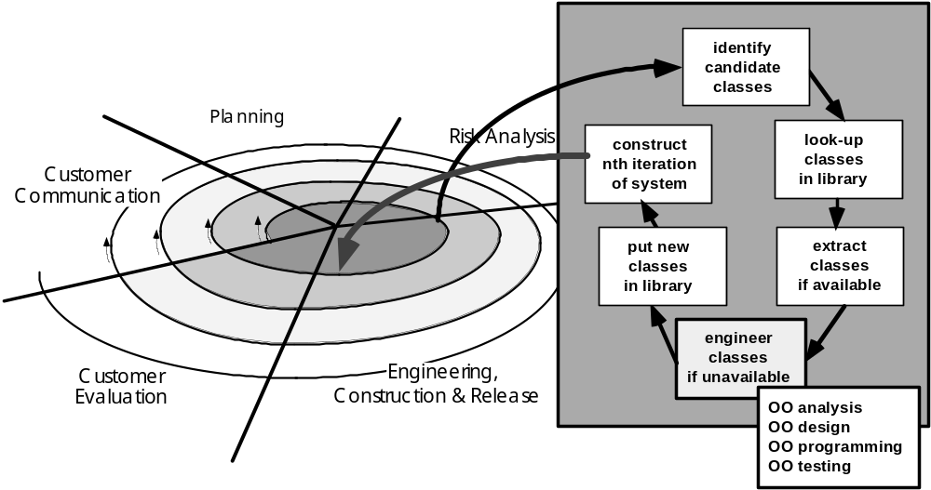
The OO Process Model

Slide 4
The OO Mindset
objects
problem domain

Slide 5
Key Concepts
classes and class hierarchies
  instances
  inheritance
  abstraction and hiding
objects
  attributes
  methods
  encapsulation
  polymorphism
messages

Slide 6
Classes
object-oriented thinking begins with the definition of a class often defined as:
  template
  generalized description
  pattern
  “blueprint” ... describing a collection of similar items
a metaclass (also called a superclass) is a collection of classes
once a class of items is defined, a specific instance of the class can be defined

Slide 7
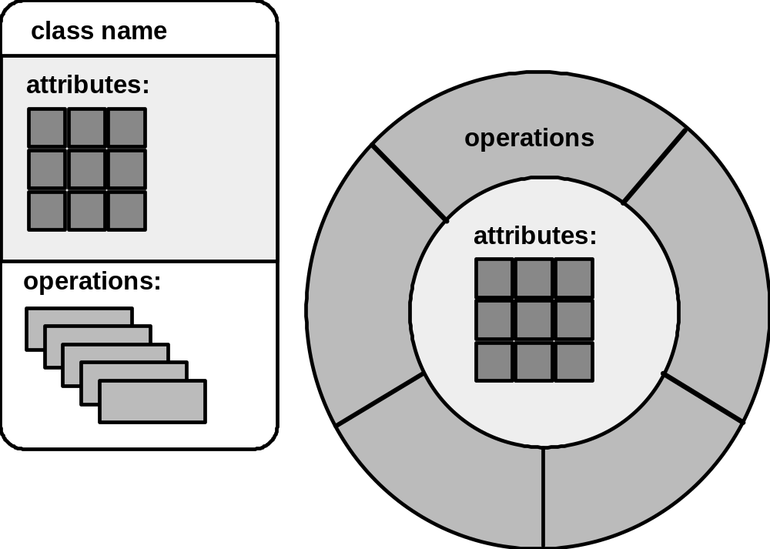
Building a Class

Slide 8
What is a Class?
occurrences
roles
things
organizational units
places
external entities
structures
class name
attributes:
operations:

Slide 9
Encapsulation/Hiding
The object encapsulates
both data and the logical
procedures required to
manipulate the data
method
# 1
method
# 2
data
method
# 6
method
# 5
method
# 4
Achieves “information hiding”

Slide 10
Class Hierarchy
furniture (superclass)
table
chair
desk
"chable"
subclasses of the
furniture superclass
instances of chair

Slide 11
Methods
(a.k.a. Operations, Services)
An executable procedure that is encapsulated in a class and is designed to operate on one or more data attributes that are defined as part of the class.
A method is invoked
via message passing.

Slide 12
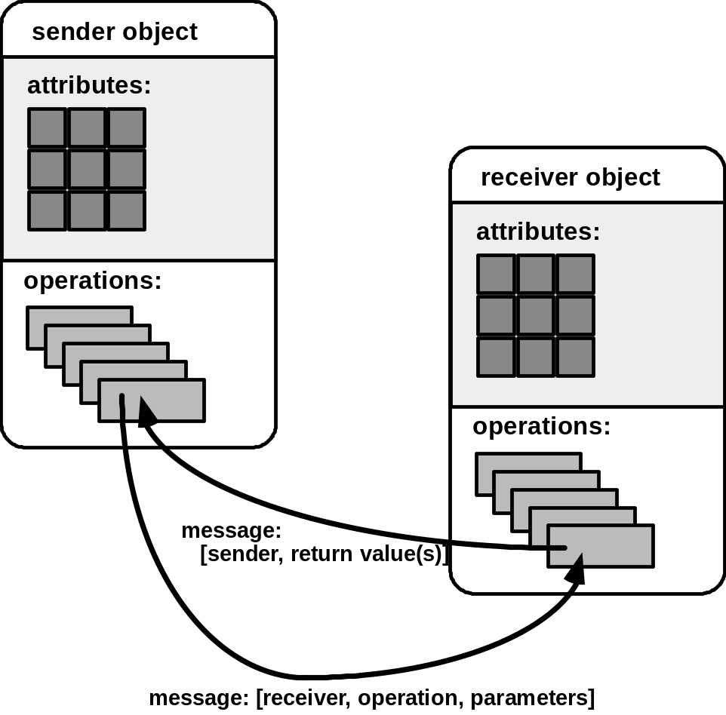
Messages

Slide 13
Chapter 21
Object-Oriented Analysis

Slide 14
Domain Analysis
class taxononmies
techncial literature
DOMAIN
SOURCES OF
reuse standards
DOMAIN
existing applications
DOMAIN
ANALYSIS
KNOWLEDGE
ANALYSIS
functional models
MODEL
customer surveys
domain languages
expert advice
current/future requirements

Slide 15
OOA- A Generic View
define use cases
extract candidate classes
establish basic class relationships
define a class hierarchy
identify attributes for each class
specify methods that service the attributes
indicate how classes/objects are related
build a behavioral model
iterate on the first five steps

Slide 16
Use Cases
a scenario that describes a “thread of usage” for a system
actors represent roles people or devices play as the system functions
users can play a number of different roles for a given scenario

Slide 17
Developing a Use Case
What are the main tasks or functions that are performed by the actor?
What system information will the the actor acquire, produce or change?
Will the actor have to inform the system about changes in the external environment?
What information does the actor desire from the system?
Does the actor wish to be informed about unexpected changes?

Slide 18
Selecting Classes—Criteria
retained information
needed services
multiple attributes
common attributes
common operations
essential requirements

Slide 19
Unified Modeling Language (UML)
User model view. This view represents the system (product) from the user’s (called “actors” in UML) perspective.
Structural model view. Data and functionality is viewed from inside the system. That is, static structure (classes, objects, and relationships) is modeled.
Behavioral model view. This part of the analysis model represents the dynamic or behavioral aspects of the system.
Implementation model view. The structural and behavioral aspects of the system are represented as they are to be built.
Environment model view. The structural and behavioral aspects of the environment in which the system is to be implemented are represented.

Slide 20
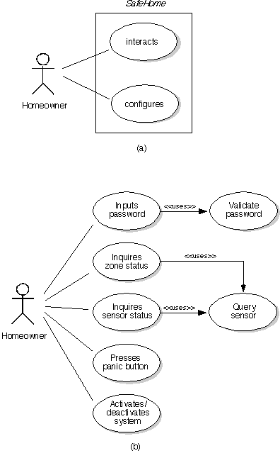
UML: Use-Case Diagram

Slide 21
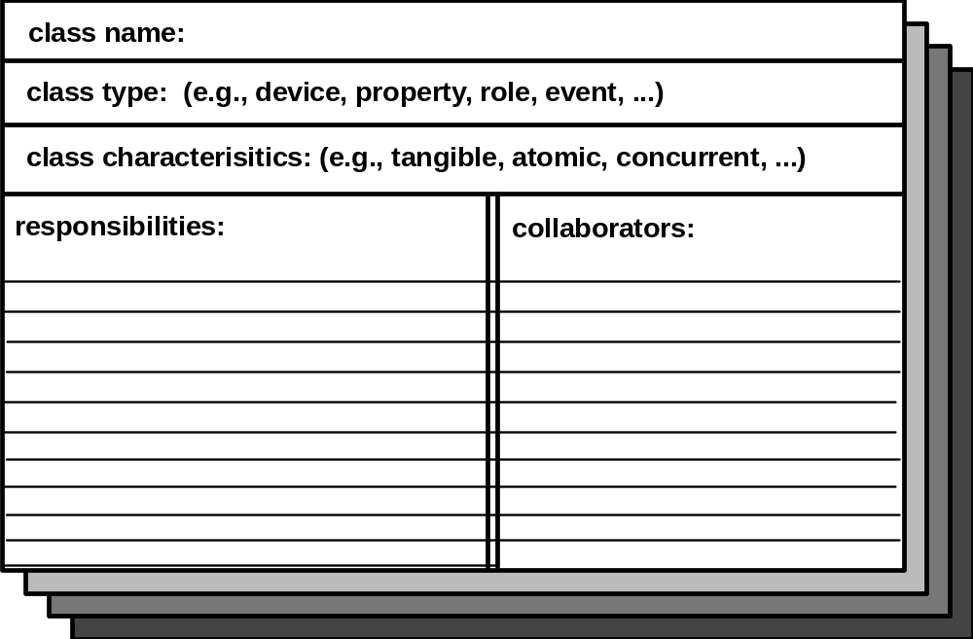
CRC Modeling

Slide 22
Guidelines for Allocating
Responsibilities to Classes
1. System intelligence should be evenly distributed.
2. Each responsibility should be stated as generally as possible.
3. Information and the behavior that is related to it should reside within the same class.
4. Information about one thing should be localized with a single class, not distributed across multiple classes.
5. Responsibilities should be shared among related classes, when appropriate.

Slide 23
Reviewing the CRC Model
1. All participants in the review (of the CRC model) are given a subset of the CRC model index cards.
2. All use-case scenarios (and corresponding use-case diagrams) should be organized into categories.
3. The review leader reads the use-case deliberately. As the review leader comes to a named object, she passes the token to the person holding the corresponding class index card.
4. When the token is passed, the holder of the class card is asked to describe the responsibilities noted on the card. The group determines whether one (or more) of the responsibilities satisfies the use-case requirement.
5. If the responsibilities and collaborations noted on the index cards cannot accommodate the use-case, modifications are made to the cards.

Slide 24
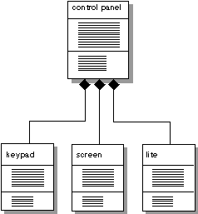
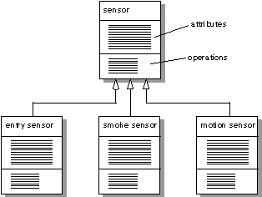
UML: Class Diagrams
Generalization-specialization
Composite aggregates

Slide 25
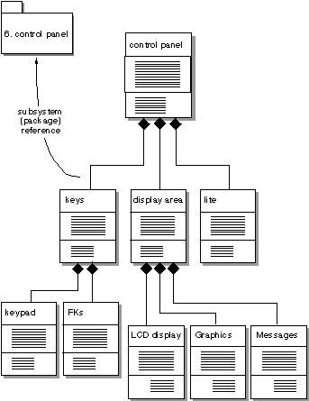
UML: Package Reference

Slide 26
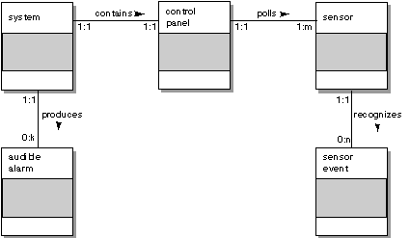
Relationships between Objects

Slide 27
Object-Behavior Model
1. Evaluate all use-cases to fully understand the sequence of interaction within the system.
2. Identify events that drive the interaction sequence and understand how these events relate to specific objects.
3. Create an event trace [RUM91] for each use-case.
4. Build a state transition diagram for the system
5. Review the object-behavior model to verify accuracy and consistency

Slide 28
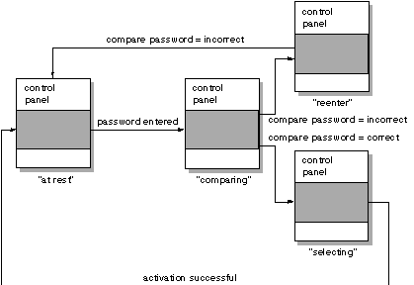
UML: State Transition

Slide 29
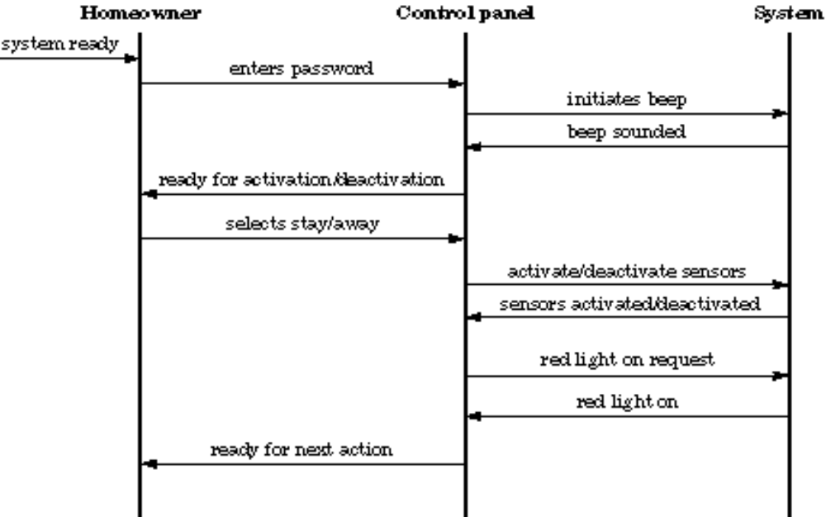
UML: Event Trace

Slide 30
Chapter 22
Object-Oriented Design

Slide 31
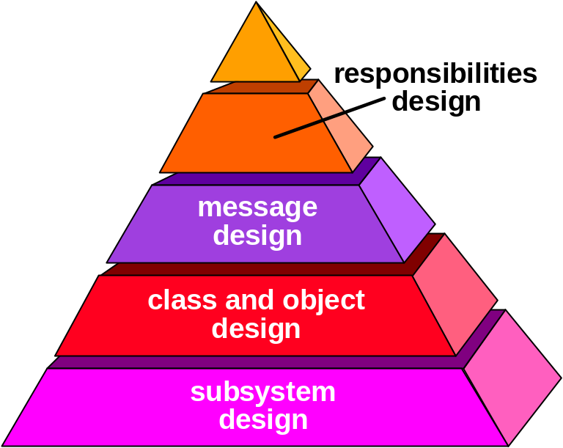
Object-Oriented Design

Slide 32
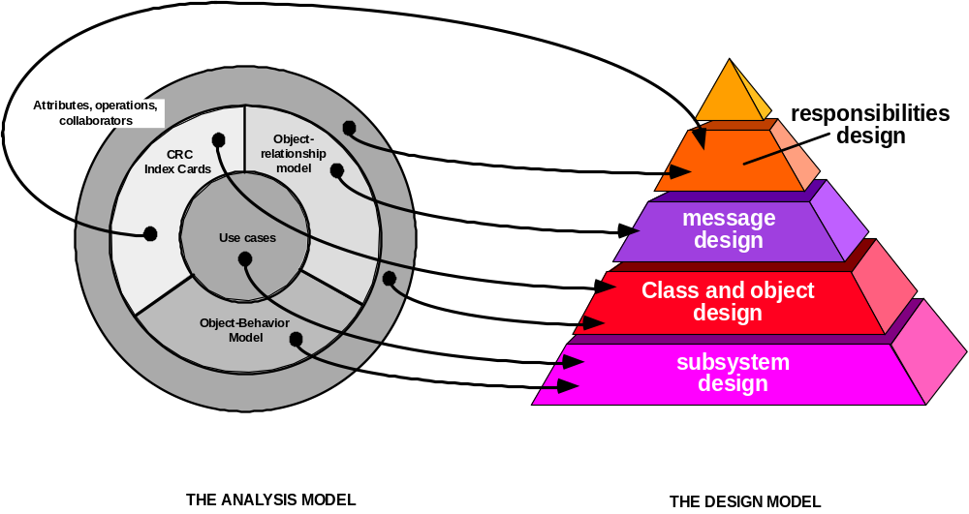
OOA and OOD

Slide 33
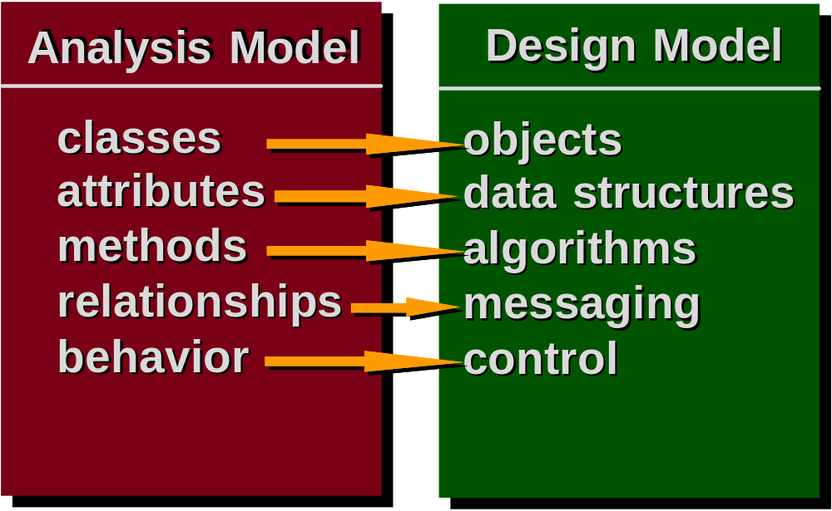
OOA and OOD

Slide 34
Design Issues
decomposability—the facility with which a design method helps the designer to decompose a large problem into subproblems that are easier to solve;
composability—the degree to which a design method ensures that program components (modules), once designed and built, can be reused to create other systems;
understandability—the ease with which a program component can be understood without reference to other information or other modules;
continuity—the ability to make small changes in a program and have these changes manifest themselves with corresponding changes in just one or a very few modules;
protection—a architectural characteristic that will reduce the propagation of side affects if an error does occur in a given module.

Slide 35
Generic Components for OOD
Problem domain component—the subsystems that are responsible for implementing customer requirements directly;
Human interaction component —the subsystems that implement the user interface (this included reusable GUI subsystems);
Task Management Component—the subsystems that are responsible for controlling and coordinating concurrent tasks that may be packaged within a subsystem or among different subsystems;
Data management component—the subsystem that is responsible for the storage and retrieval of objects.

Slide 36
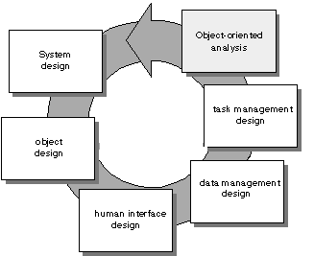
Process Flow for OOD

Slide 37
System Design Process
• Partition the analysis model into subsystems.
• Identify concurrency that is dictated by the problem.
• Allocate subsystems to processors and tasks.
• Develop a design for the user interface.
• Choose a basic strategy for implementing data management.
• Identify global resources and the control mechanisms required to access them.
• Design an appropriate control mechanism for the system, including task management.
• Consider how boundary conditions should be handled.
• Review and consider trade-offs.

Slide 38
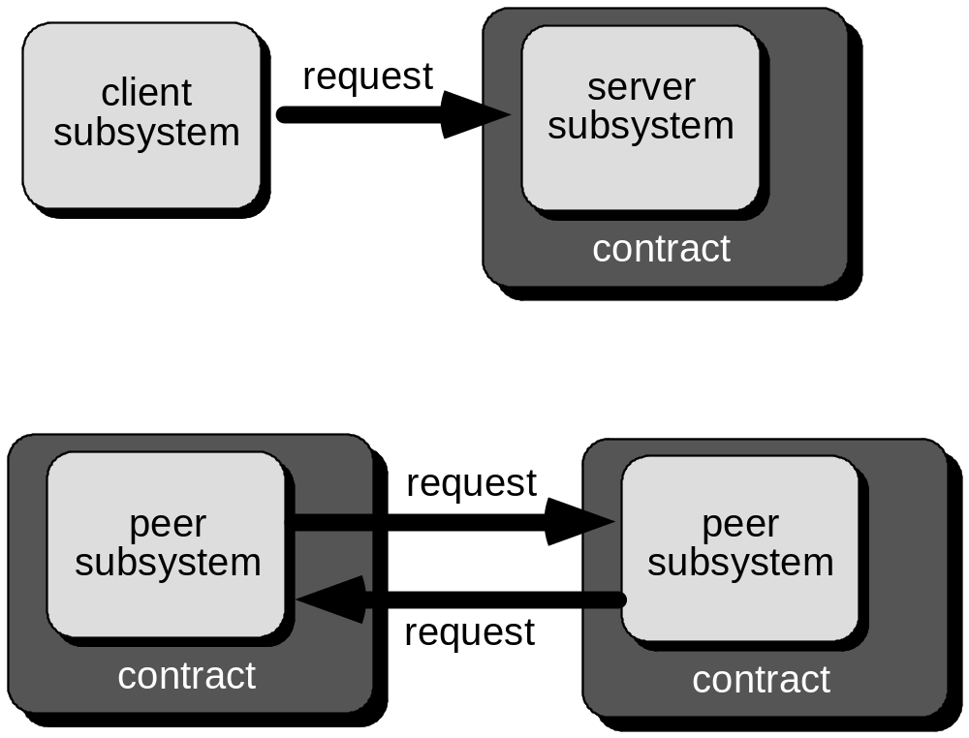
System Design

Slide 39
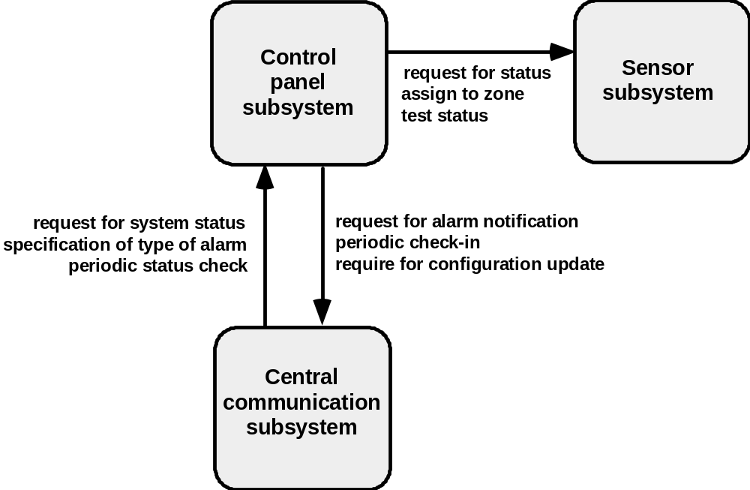
Subsystem Example

Slide 40
Subsystem Design Criteria
• The subsystem should have a well-defined interface through which all communication with the rest of the system occurs.
• With the exception of a small number of “communication classes,” the classes within a subsystem should collaborate only with other classes within the subsystem.
• The number of subsystems should be kept small.
• A subsystem can be partitioned internally to help reduce complexity.

Slide 41
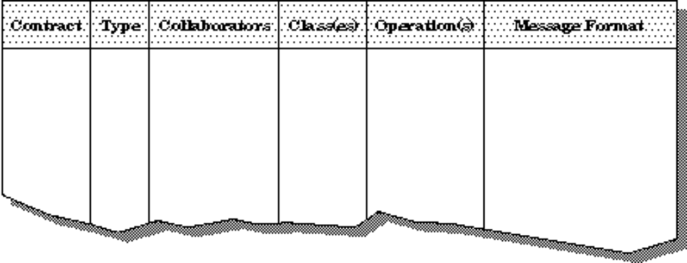
Subsystem Collaboration Table

Slide 42
Object Design
A protocol description establishes the interface of an object by defining each message that the object can receive and the related operation that the object performs
An implementation description shows implementation details for each operation implied by a message that is passed to an object.
  information about the object's private part
  internal details about the data structures that describe the object’s attributes
  procedural details that describe operations

Slide 43
Design Patterns
... you’ll find recurring patterns of classes and communicating objects in many object-oriented systems. These patterns solve specific design problems and make object-oriented design more flexible, elegant, and ultimately reusable. They help designers reuse successful designs by basing new designs on prior experience. A designer who is familiar with such patterns can apply them immediately to design problems without having to rediscover them.
Gamma and his colleagues [GAM95]

Slide 44
Design Pattern Attributes
The design pattern name is an abstraction that conveys significant meaning about it applicability and intent.
The problem description indicates the environment and conditions that must exist to make the design pattern applicable.
The pattern characteristics indicate the attributes of the design that may be adjusted to enable the pattern to accommodate into a variety of problems.
The consequences associated with the use of a design pattern provide an indication of the ramifications of design decisions.

Slide 45
Chapter 23
Object-Oriented Testing

Slide 46
Object-Oriented Testing
begins by evaluating the correctness and consistency of the OOA and OOD models
testing strategy changes
  the concept of the ‘unit’ broadens due to encapsulation
  integration focuses on classes and their execution across a ‘thread’ or in the context of a usage scenario
  validation uses conventional black box methods
test case design draws on conventional methods, but also encompasses special features

Slide 47
Broadening the View of “Testing”
It can be argued that the review of OO analysis and design models is especially useful because the same semantic constructs (e.g., classes, attributes, operations, messages) appear at the analysis, design, and code level. Therefore, a problem in the definition of class attributes that is uncovered during analysis will circumvent side effects that might occur if the problem were not discovered until design or code (or even the next iteration of analysis).

Slide 48
Testing the CRC Model
1. Revisit the CRC model and the object-relationship model.
2. Inspect the description of each CRC index card to determine if a delegated responsibility is part of the collaborator’s definition.
3. Invert the connection to ensure that each collaborator that is asked for service is receiving requests from a reasonable source.
4. Using the inverted connections examined in step 3, determine whether other classes might be required or whether responsibilities are properly grouped among the classes.
5. Determine whether widely requested responsibilities might be combined into a single responsibility.
6. Steps 1 to 5 are applied iteratively to each class and through each evolution of the OOA model.

Slide 49
OOT Strategy
class testing is the equivalent of unit testing
  operations within the class are tested
  the state behavior of the class is examined
integration applied three different strategies
  thread-based testing—integrates the set of classes required to respond to one input or event
  use-based testing—integrates the set of classes required to respond to one use case
  cluster testing—integrates the set of classes required to demonstrate one collaboration

Slide 50
OOT—Test Case Design
Berard [BER93] proposes the following approach:
1. Each test case should be uniquely identified and should be explicitly associated with the class to be tested,
2. The purpose of the test should be stated,
3. A list of testing steps should be developed for each test and should contain [BER94]:
  a. a list of specified states for the object that is to be tested
b. a list of messages and operations that will be exercised as a consequence of the test
c. a list of exceptions that may occur as the object is tested
d. a list of external conditions (i.e., changes in the environment external to the software that must exist in order to properly conduct the test)
e. supplementary information that will aid in understanding or implementing the test.

Slide 51
OOT Methods: Random Testing
Random testing
  identify operations applicable to a class
  define constraints on their use
  identify a miminum test sequence
    an operation sequence that defines the minimum life history of the class (object)
  generate a variety of random (but valid) test sequences
    exercise other (more complex) class instance life histories

Slide 52
OOT Methods: Partition Testing
Partition Testing
  reduces the number of test cases required to test a class in much the same way as equivalence partitioning for conventional software
  state-based partitioning
    categorize and test operations based on their ability to change the state of a class
  attribute-based partitioning
    categorize and test operations based on the attributes that they use
  category-based partitioning
    categorize and test operations based on the generic function each performs

Slide 53
OOT Methods: Inter-Class Testing
Inter-class testing
  For each client class, use the list of class operators to generate a series of random test sequences. The operators will send messages to other server classes.
  For each message that is generated, determine the collaborator class and the corresponding operator in the server object.
  For each operator in the server object (that has been invoked by messages sent from the client object), determine the messages that it transmits.
  For each of the messages, determine the next level of operators that are invoked and incorporate these into the test sequence

Slide 54
Chapter 24
Technical Metrics for
Object-Oriented Systems

Slide 55
Distinguishing Characteristics
Berard [BER95] argues that the following characteristics require
that special OO metrics be developed:
Localization—the way in which information is concentrated in a program
Encapsulation—the packaging of data and processing
Information hiding—the way in which information about operational details is hidden by a secure interface
Inheritance—the manner in which the responsibilities of one class are propagated to another
Abstraction—the mechanism that allows a design to focus on essential details

Slide 56
Class-Oriented Metrics
Proposed by Chidamber and Kemerer:
weighted methods per class
depth of the inheritance tree
number of children
coupling between object classes
response for a class
lack of cohesion in methods

Slide 57
Class-Oriented Metrics
Proposed by Lorenz and Kidd [LOR94]:
class size
number of operations overridden by a subclass
number of operations added by a subclass
specialization index

Slide 58
Class-Oriented Metrics
The MOOD Metrics Suite
Method inheritance factor
Coupling factor
Polymorphism factor

Slide 59
Operation-Oriented Metrics
Proposed by Lorenz and Kidd [LOR94]:
average operation size
operation complexity
average number of parameters per operation

Slide 60
Testability Metrics
Proposed by Binder [BIN94]:
encapsulation related
  lack of cohesion in methods
  percent public and protected
  public access to data members
inheritance related
  number of root classes
  fan in
  number of children and depth of inheritance tree

Slide 61
OO Project Metrics
Proposed by Lorenz and Kidd [LOR94]:
number of scenario scripts
number of key classes
number of subsystems

Slide 62
Chapter 25
Formal Methods

Slide 63
Problems with
Conventional Specification
contradictions
ambiguities
vagueness
imcompleteness
mixed levels of abstraction

Slide 64
Formal Methods Concepts
data invariant—a condition that is true throughout the execution of the system that contains a collection of data
state—the stored data which a system accesses and alters
operation—an action that takes place in a system and reads or writes data to a state
  precondition defines the circumstances in which a particular operation is valid
  postcondition defines what happens when an operation has completed its action

Slide 65
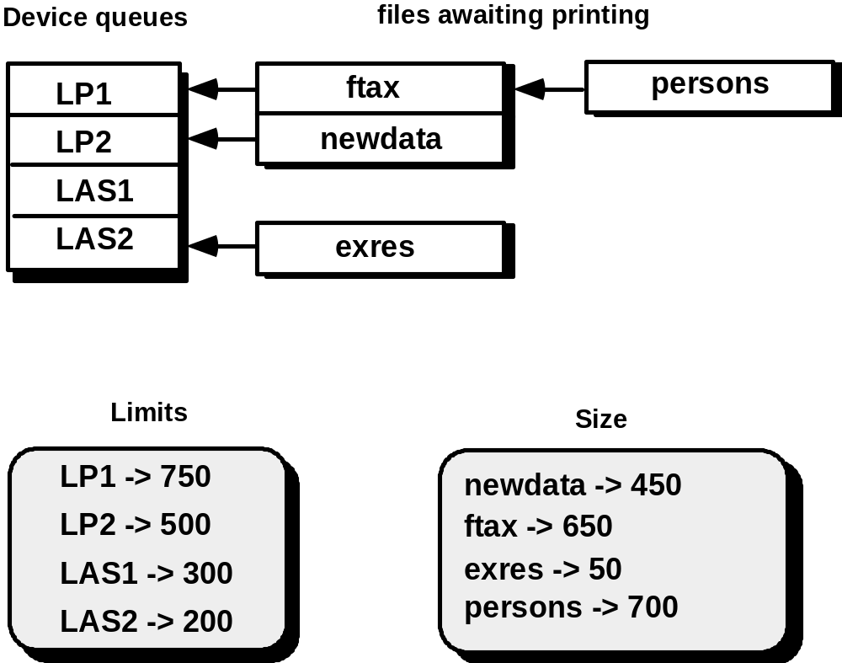
An Example—Print Spooler

Slide 66
States and Data Invariant
The state of the spooler is represented by the four components Queues, OutputDevices, Limits, and Sizes.
The data invariant has five components:
• Each output device is associated with an upper limit of print lines
• Each output device is associated with a possibly nonempty queue of files awaiting printing
• Each file is associated with a size
• Each queue associated with an output device contains files that have a size less than the upper limit of the output device
• There will be no more than MaxDevs output devices administered by the spooler

Slide 67
Operations
An operation which adds a new output device to the spooler together with its associated print limit
An operation which removes a file from the queue associated with a particular output device
An operation which adds a file to the queue associated with a particular output device
An operation which alters the upper limit of print lines for a particular output device
An operation which moves a file from a queue associated with an output device to another queue associated with a second output device

Slide 68
Pre- & Postconditions
For the first operation (adds a new output device to the spooler together with its associated print limit):
Precondition: the output device name does not already exist and that there are currently less than MaxDevs output devices known to the spooler
Postcondition: the name of the new device is added to the collection of existing device names, a new entry is formed for the device with no files being associated with its queue, and the device is associated with its print limit.

Slide 69
Mathematical Concepts
sets and constructive set specification
set operators
logic operators
  e.g., i, j: • i > j i² => j²
  which states that, for every pair of values in the set of natural numbers, if i is greater than j, then i² is greater than j².
sequences

Slide 70
The Z Language
organized into schemas
  defines variables
  establishes relationships between variables
  the analog for a “module” in conventional languages
notation described in Table 25.1, SEPA, 5/e

Slide 71
Chapter 26
Cleanroom Software Engineering

Slide 72
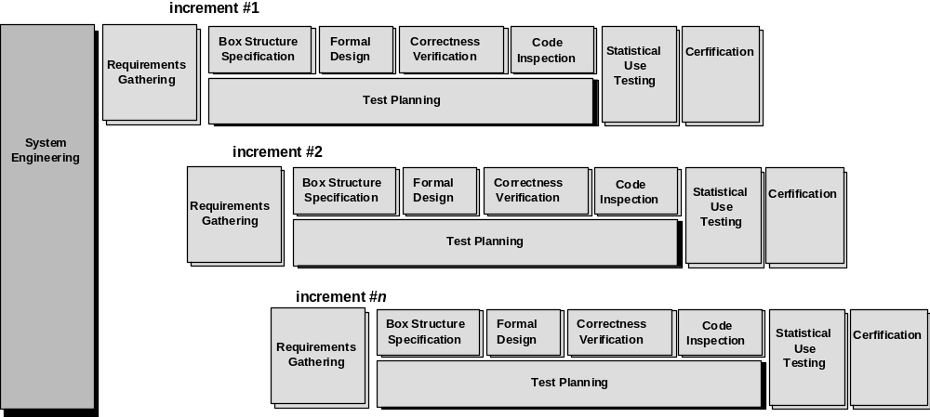
The Cleanroom Process Model

Slide 73
The Cleanroom Strategy-I
Increment Planning—adopts the incremental strategy
Requirements Gathering—defines a description of customer level requirements (for each increment)
Box Structure Specification—describes the functional specification
Formal Design—specifications (called “black boxes”) are iteratively refined (with an increment) to become analogous to architectural and procedural designs (called “state boxes” and “clear boxes,” respectively).
Correctness Verification—verification begins with the highest level box structure (specification) and moves toward design detail and code using a set of “correctness questions.” If these do not demonstrate that the specification is correct, more formal (mathematical) methods for verification are used.
Code Generation, Inspection and Verification—the box structure specifications, represented in a specialized language, are transmitted into the appropriate programming language.

Slide 74
The Cleanroom Strategy-II
Statistical Test Planning—a suite of test cases that exercise of “probability distribution” of usage are planned and designed
Statistical Usage Testing—execute a series of tests derived from a statistical sample (the probability distribution noted above) of all possible program executions by all users from a targeted population
Certification—once verification, inspection and usage testing have been completed (and all errors are corrected) the increment is certified as ready for integration.

Slide 75
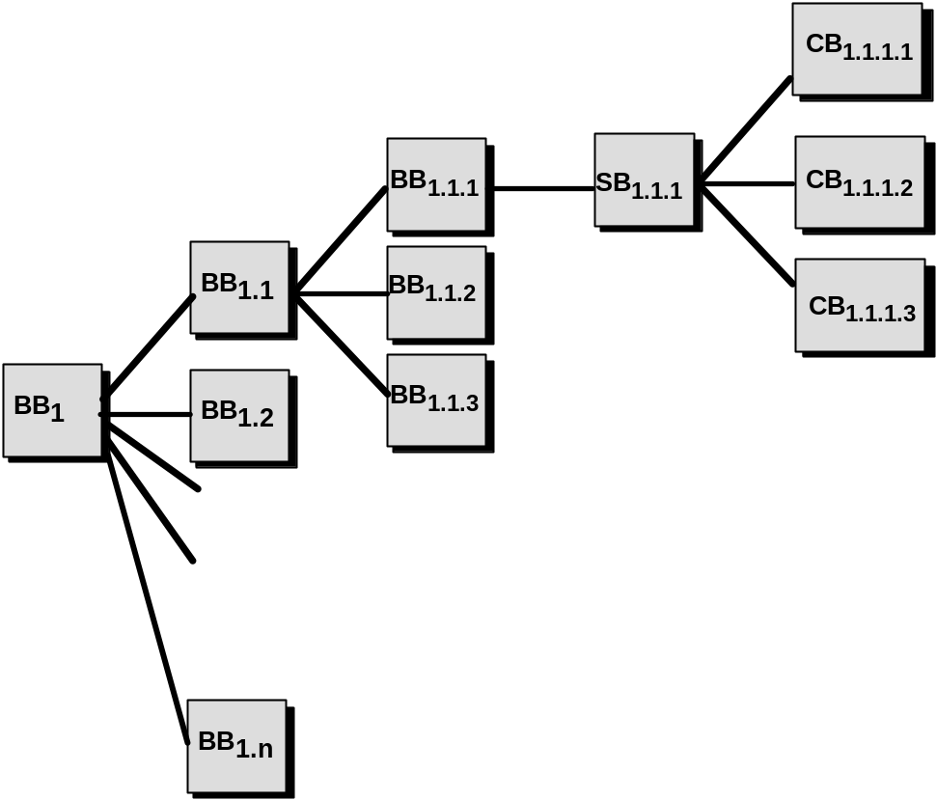
Box Structure Specification
black box
clear box
state box

Slide 76
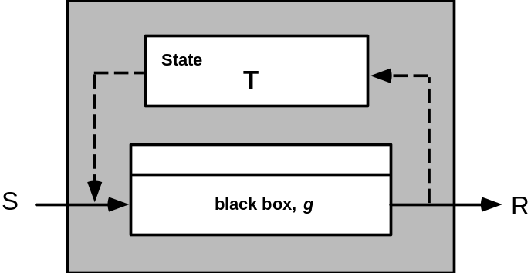
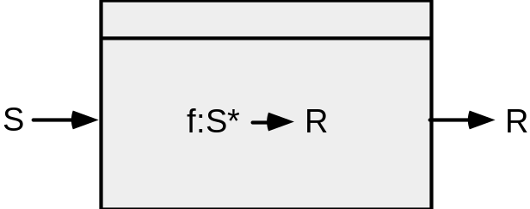
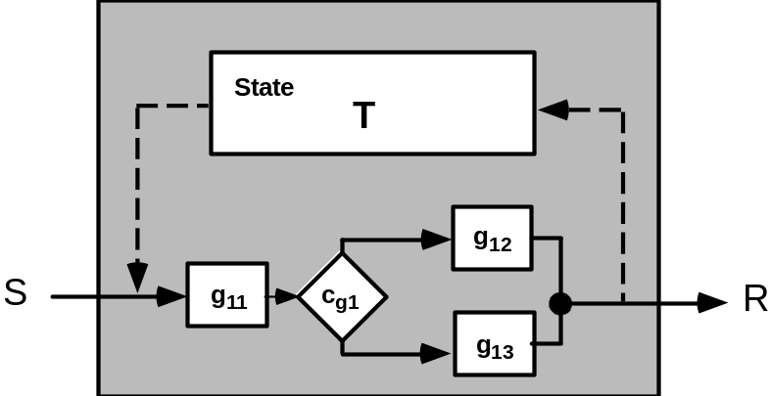
Box Structures
black box
state box
clear box

Slide 77
Design Refinement & Verification
If a function f is expanded into a sequence g and h, the correctness condition for all input to f is:
• Does g followed by h do f?
When a function f is refined into a conditional (if-then-else), the correctness condition for all input to f is:
• Whenever condition <c> is true does g do f and whenever <c> is false, does h do f?
When function f is refined as a loop, the correctness conditions for all input to f is:
When function f is refined as a loop, the correctness conditions for all input to f is:
• Is termination guaranteed?
• Whenever <c> is true does g followed by f do f, and whenever <c> is false, does skipping the loop still do f?

Slide 78
Advantages of Design Verification
It reduces verification to a finite process.
It lets cleanroom teams verify every line of design and code.
It results in a near zero defect level.
It scales up.
It produces better code than unit testing.

Slide 79
Cleanroom Testing
statistical use testing
  tests the actual usage of the program
determine a “usage probability distribution”
  analyze the specification to identify a set of stimuli
  stimuli cause software to change behavior
  create usage scenarios
  assign probability of use to each stimuli
  test cases are generated for each stimuli according to the usage probability distribution

Slide 80
Certification
1. Usage scenarios must be created.
2. A usage profile is specified.
3. Test cases are generated from the profile.
4. Tests are executed and failure data are recorded and analyzed.
5. Reliability is computed and certified.

Slide 81
Certification Models
Sampling model. Software testing executes m random test cases and is certified if no failures or a specified numbers of failures occur. The value of m is derived mathematically to ensure that required reliability is achieved.
Component model. A system composed of n components is to be certified. The component model enables the analyst to determine the probability that component i will fail prior to completion.
Certification model. The overall reliability of the system is projected and certified.

Slide 82
Chapter 27
Component-Based
Software Engineering

Slide 83
The Key Questions
When faced with the possibility of reuse, the software team asks:
  Are commercial off-the-shelf (COTS) components available to implement the requirement?
  Are internally-developed reusable components available to implement the requirement?
  Are the interfaces for available components compatible within the architecture of the system to be built?
At the same time, they are faced with the following impediments to reuse ...

Slide 84
Impediments to Reuse
Few companies and organizations have anything that even slightly resembles a comprehensive software reusability plan.
Although an increasing number of software vendors currently sell tools or components that provide direct assistance for software reuse, the majority of software developers do not use them.
Relatively little training is available to help software engineers and managers understand and apply reuse.
Many software practitioners continue to believe that reuse is “more trouble than it’s worth.”
Many companies continue to encourage of software development methodologies which do not facilitate reuse
Few companies provide an incentives to produce reusable program components.

Slide 85
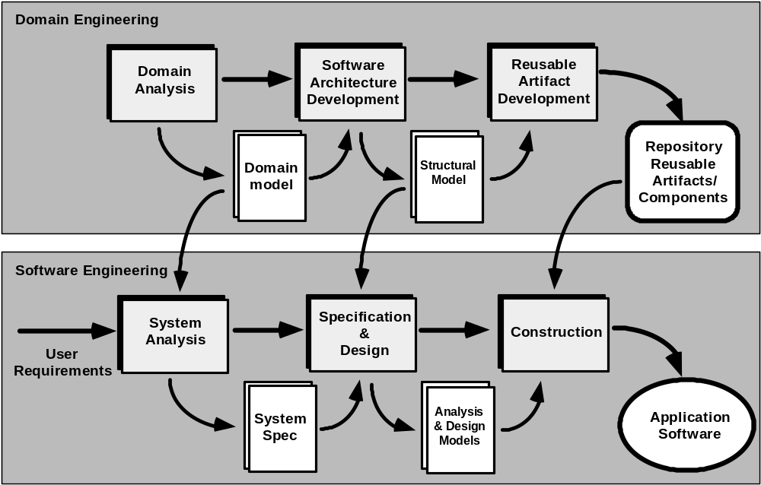
The CBSE Process

Slide 86
Domain Engineering
1. Define the domain to be investigated.
2. Categorize the items extracted from the domain.
3. Collect a representative sample of applications in the domain.
4. Analyze each application in the sample.
5. Develop an analysis model for the objects.

Slide 87
Identifying Reusable Components
• Is component functionality required on future implementations?
• How common is the component's function within the domain?
• Is there duplication of the component's function within the domain?
• Is the component hardware-dependent?
• Does the hardware remain unchanged between implementations?
• Can the hardware specifics be removed to another component?
• Is the design optimized enough for the next implementation?
• Can we parameterize a nonreusable component so that it becomes reusable?
• Is the component reusable in many implementations with only minor changes?
• Is reuse through modification feasible?
• Can a nonreusable component be decomposed to yield reusable components?
• How valid is component decomposition for reuse?

Slide 88
Structural Modeling
every application has structural patterns that have the potential for reuse
a “structure point” is a construct with the structure
  A structure point is an abstraction that should have a limited number of instances. Restating this in object-oriented jargon , the size of the class hierarchy should be small.
  The rules that govern the use of the structure point should be easily understood. In addition, the interface to the structure point should be relatively simple.
  The structure point should implement information hiding by hiding all complexity contained within the structure point itself. This reduces the perceived complexity of the overall system.

Slide 89
Component-Based Development
a library of components must be available
components should have a consistent structure
a standard should exist, e.g.,
  OMG/CORBA
  MS COM
  JavaBeans

Slide 90
CBSE Activities
Component qualification
Component adaptation
Component composition
Component update

Slide 91
Qualification
Before a component can be used, you must consider:
• application programming interface (API)
• development and integration tools required by the component
• run-time requirements including resource usage (e.g., memory or storage), timing or speed, and network protocol
• service requirements including operating system interfaces and support from other components
• security features including access controls and authentication protocol
• embedded design assumptions including the use of specific numerical or non-numerical algorithms
• exception handling

Slide 92
Adaptation
The implication of “easy integration” is:
(1) that consistent methods of resource management have been implemented for all components in the library;
(2) that common activities such as data management exist for all components, and
(3) that interfaces within the architecture and with the external environment have been implemented in a consistent manner.

Slide 93
Composition
An infrastructure must be established to bind components together
Architectural ingredients for composition include:
  Data exchange model
  Automation
  Structured storage
  Underlying object model

Slide 94
Classification
Enumerated classification—components are described by defining a hierarchical structure in which classes and varying levels of subclasses of software components are defined
Faceted classification—a domain area is analyzed and a set of basic descriptive features are identified
Attribute-value classification—a set of attributes are defined for all components in a domain area

Slide 95
Chapter 28
Client/Server Software Engineering

Slide 96
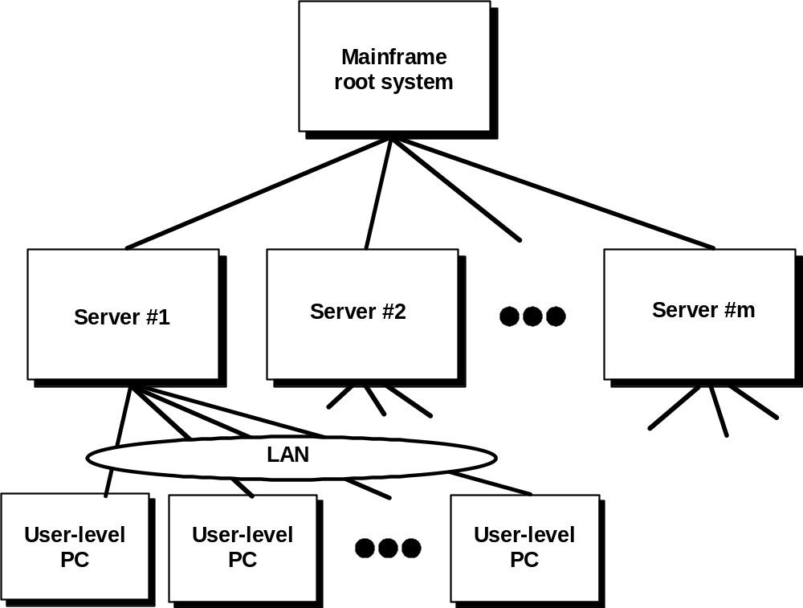
C/S Architectures

Slide 97
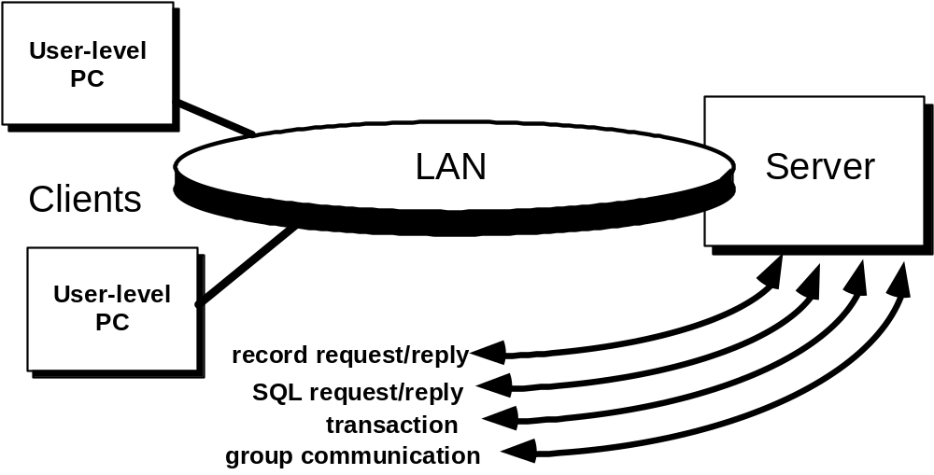
Architecture Options

Slide 98
Software Components
User Interaction/Presentation Component—implements all functions associated with a graphical user interface (GUI).
Application Component—implements the requirements defined by the application within the context of the domain in which the application operates.
Database Management—performs the data manipulation and management required by an application. Data manipulation and management may be as simple as the transfer of a record or as complex the processing of sophisticated SQL transactions.
Middleware—comprises software elements that exist on both the client and the server
  elements of network operating systems
  software that supports database specific applications
  object-request broker (ORB) standards
  groupware technologies
  communication management
  other features that facilitate the client-server connection

Slide 99
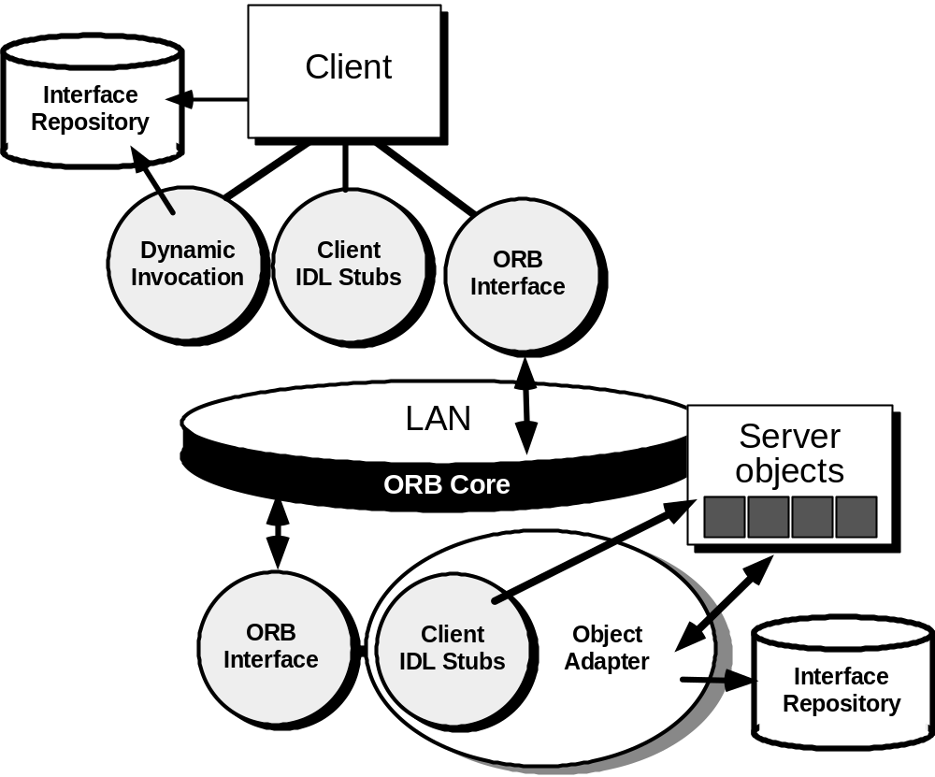
Object-Request Brokers

Slide 100
C/S Software Engineering
conventional and/or OO analysis methods are generally applicable
basic design principles and methods can be applied but
  data design dominates
  event driven paradigm is chosen
  GUI design is almost always requireder suited to C/S
specialized construction tools are desirable
testing strategy differs

Slide 101
C/S Testing
Application function tests. The functionality of client applications is tested using conventional methods
Server tests. The coordination and data management functions of the server are tested. Server performance (overall response time and data throughput) is also considered.
Database tests. The accuracy and integrity of data stored by the server is tested. Archiving is also tested.
Transaction testing. A series of tests are created to ensure that each class of transactions is processed according to requirements.
Network communication testing. These tests verify the communication among the nodes of the network occurs correctly and that message passing, transactions, and related network traffic occur without error. Network security tests may also be conducted as part of this testing activity.

Slide 102
Chapter 29
Web Engineering

Slide 103
Attributes of
Web-Based Applications
Network intensive. By its nature, a WebApp is network intensive. It resides on a network and must serve the needs of a diverse community of clients.
Content-Driven. In many cases, the primary function of a WebApp is to use hypermedia to present text, graphics, audio, and video content to the end-user.
Continuous evolution. Unlike conventional application software that evolves over a series of planned, chronologically-spaced releases, Web applications evolve continuously.

Slide 104
WebApp Characteristics
Immediacy. Web-based applications have an immediacy [NOR99] that is not found in any other type of software. That is, the time to market for a complete Web-site can be a matter of a few days or weeks.
Security. In order to protect sensitive content and provide secure modes of data transmission, strong security measures must be implemented throughout the infrastructure that supports a WebApp and within the application itself.
Aesthetics. An undeniable part of the appeal of a WebApp is its look and feel. When an application has been designed to market or sell products or ideas, aesthetics may have as much to do with success as technical design.

Slide 105
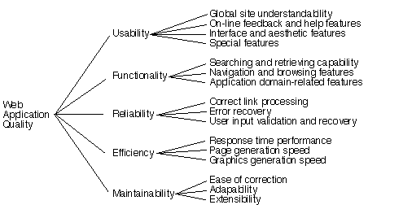
WebApp Quality Factors

Slide 106
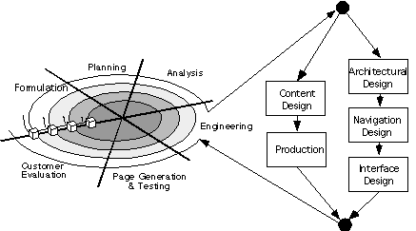
The WebE Process

Slide 107
Formulation
Allows the customer and developer to establish a common set of goals
Address three questions:
  What is the main motivation for the WebApp?
  Why is the WebApp needed?
  Who will use the WebApp?
Defines two categories of goals”
  Informational goals—indicate an intention to provide specific content and/or information the the end user
  Applicative goals—indicate the ability to perform some task within the WebApp

Slide 108
Analysis for WebE
Content Analysis. The full spectrum of content to be provided by the WebApp is identified, including text, graphics and images, video, and audio data. Data modeling can be used to identify and describe each of the data objects.
Interaction Analysis. The manner in which the user interacts with the WebApp is described in detail. Use-cases can be developed to provide detailed descriptions of this interaction.
Functional Analysis. The usage scenarios (use-cases) created as part of interaction analysis define the operations that will be applied to WebApp content and imply other processing functions. All operations and functions are described in detail.
Configuration Analysis. The environment and infrastructure in which the WebApp resides are described in detail.

Slide 109
Design for WebE
Architectural design — laying out the page structure of the WebApp
Navigation design — defining the manner in which pages will be navigated
Interface design — establishing consistent and effective user interaction mechanisms

Slide 110
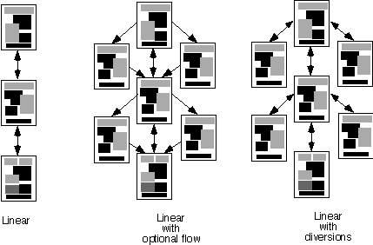
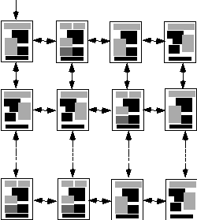
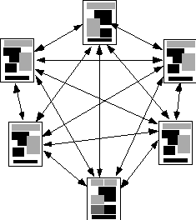
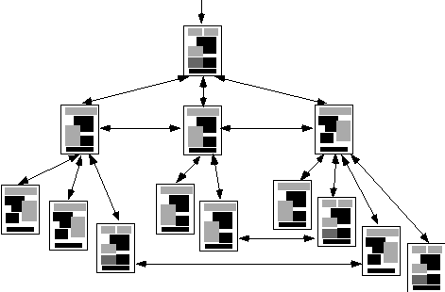
Architectural Styles
Linear
structure
Grid
structure
Network
structure
Hierarchical
structure

Slide 111
Navigation Design
identify the semantics of navigation for different users of the site
  User roles must be defined
  Semantics of navigation for each role must be identified
  A semantic navigation unit (SNU) should be defined for each goal associated with each user
  Ways of navigating (WoN) are defined
define the mechanics (syntax) of achieving the navigation
  options are text-based links, icons, buttons and switches, and graphical metaphors

Slide 112
Interface Design Guidelines
• Server errors, even minor ones, are likely to cause a user to leave the Web site and look elsewhere for information or services.
• Reading speed on a computer monitor is approximately 25 percent slower than reading speed for hardcopy. Therefore, do not force the user to read voluminous amounts of text.
• Avoid “under construction” signs—they raise expectations and cause an unnecessary link that is sure to disappoint.
• Users prefer not to scroll. Important information should be placed within the dimensions of a typical browser window.
• Navigation menus and headbars should be designed consistently and should be available on all pages that are available to the user. The design should not rely on browser functions to assist in navigation.
• Aesthetics should never supersede functionality.
• Navigation options should be obvious, even to the casual user. The user should have to search the screen to determine how to link to other content or services.

Slide 113
Testing for WebE – I
1. The content model for the WebApp is reviewed to uncover errors. This ‘testing’ activity is similar in many respects to copy-editing for a written document.
2. The design model for the WebApp is reviewed to uncover navigation errors. Use-cases, derived as part of the analysis activity, allow a Web engineer to exercise each usage scenario against the architectural and navigation design.
3. Selected processing components and Web pages are unit tested. When WebApps are considered, the concept of the unit changes. Each Web page encapsulates content, navigation links and processing elements (forms, scripts, applets).
4. The architecture is constructed and integration tests are conducted. The strategy for integration testing depends on the architecture that has been chosen
• a linear, grid, or simple hierarchical structure—integration is similar to conventional software
• mixed hierarchy or network (Web) architecture — integration testing is similar to the approach used for OO systems.

Slide 114
Testing for WebApps – II
5. The assembled WebApp is tested for overall functionality and content delivery. Like conventional validation, the validation of Web-based systems and applications focuses on user visible actions and user recognizable outputs from the system.
6. The WebApp is implemented in a variety of different environmental configurations and is tested for compatibility with each configuration. A cross reference matrix the defines all probable operating systems, browsers, hardware platforms, and communications protocols is created. Tests are then conducted to uncover errors associated with each possible configuration.
7. The WebApp is tested by a controlled and monitored population of end-users. A population of users that encompasses every possible user role is chosen. The WebApp is exercised by these users and the results of their interaction with the system are evaluated for content and navigation errors, usability concerns, compatibility concerns, and WebApp reliability and performance.

Slide 115
Project Management for WebE
Initiate the project
  Many of the analysis activities should be performed internally even if the project is outsourced
  A rough design for the WebApp should be developed internally.
  A rough project schedule, including not only final delivery dates, but also milestone dates should be developed.
  The degree of oversight and interaction by the contractor with the vendor should be identified.

Slide 116
Project Management for WebE
Select candidate outsourcing vendors
  interview past clients to determine the Web vendor’s professionalism, ability to meet schedule and cost commitments, and ability to communicate effectively:
  determine the name of the vendor’s chief Web engineer(s) for successful past projects (and later, be certain that this person is contractually obligated to be involved in your project
  carefully examine samples of the vendor’s work that are similar in look and feel (and business area) to the WebApp that is to be contracted.

Slide 117
Project Management for WebE
Assess the validity of price quotes and the reliability of estimates
  Does the quoted cost of the WebApp provide a direct or indirect return-on-investment that justifies the project?
  Does the vendor that has provided the quote exhibit the professionalism and experience we require?
Establish the degree of project management expected from both parties
Assess the development schedule
  WBS should have high granularity
  Milestones should be defined at tight intervals

Slide 118
SCM for WebE
WebApp content is extremely varied
  SCO’s must be defined
  The “longevity of the SCO must be identified
Many different people participate in content creation
  Determine who “owns” the WebApp
  Establish who can make changes and who approves them
Manage scale
  As a small WebApp grows, the impact of an seemingly insignificant change can be magnified

Slide 119
Chapter 30
Reengineering

Slide 120
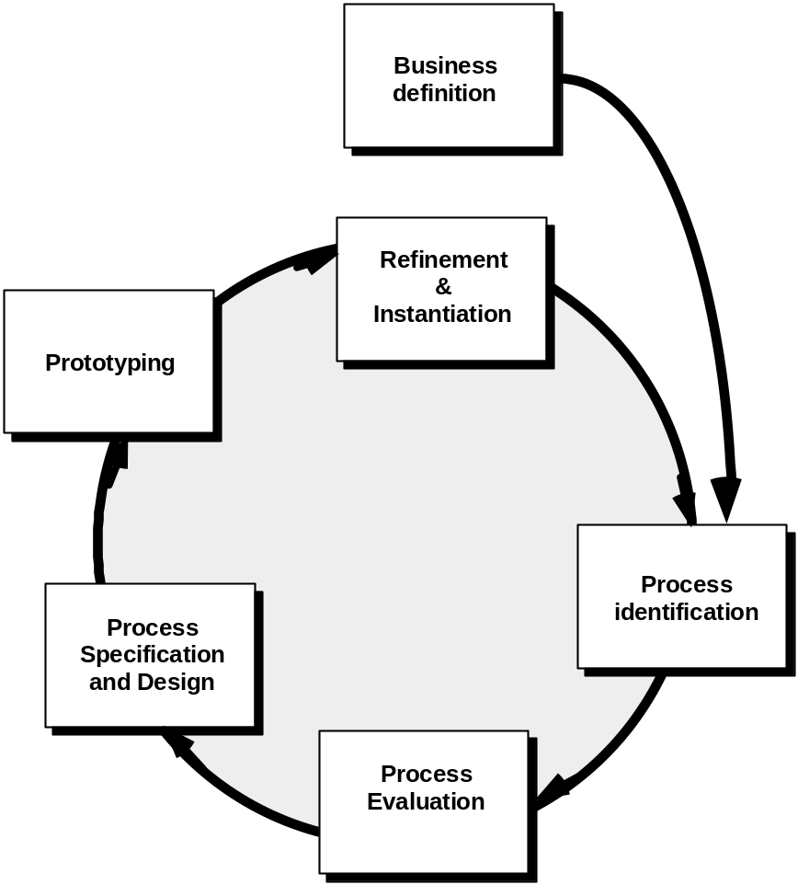
Business Process Reengineering (BPR)

Slide 121
BPR Principles
Organize around outcomes, not tasks.
Have those who use the output of the process perform the process.
Incorporate information processing work into the real work that produces the raw information.
Treat geographically dispersed resources as though they were centralized.
Link parallel activities instead of integrated their results. When different
Put the decision point where the work is performed, and build control into the process.
Capture data once, at its source.

Slide 122
Software Reengineering
f
o
r
i
n
v
e
n
t
o
r
y
w
a
r
d
e
n
g
i
a
n
a
l
y
s
i
s
n
e
e
r
i
n
g
d
a
t
a
d
o
c
u
m
e
n
t
r
e
s
t
r
u
c
t
u
r
i
n
g
r
e
s
t
r
u
c
t
u
r
i
n
g
r
e
v
e
r
s
e
c
o
d
e
e
n
g
i
n
e
e
r
i
n
g
r
e
s
t
r
u
c
t
u
r
i
n
g

Slide 123
Inventory Analysis
build a table that contains all applications
establish a list of criteria, e.g.,
  name of the application
  year it was originally created
  number of substantive changes made to it
  total effort applied to make these changes
  date of last substantive change
  effort applied to make the last change
  system(s) in which it resides
  applications to which it interfaces, ...
analyze and prioritize to select candidates for reengineering

Slide 124
Restructuring
Document Restructuring
  options range from doing nothing to regeneration of all documentation for critical system
Reverse Engineering
  the intent here is to achieve design recovery
Code Restructuring
  rebuild spaghetti bowl code
Data Restructuring
  data architecture

Slide 125
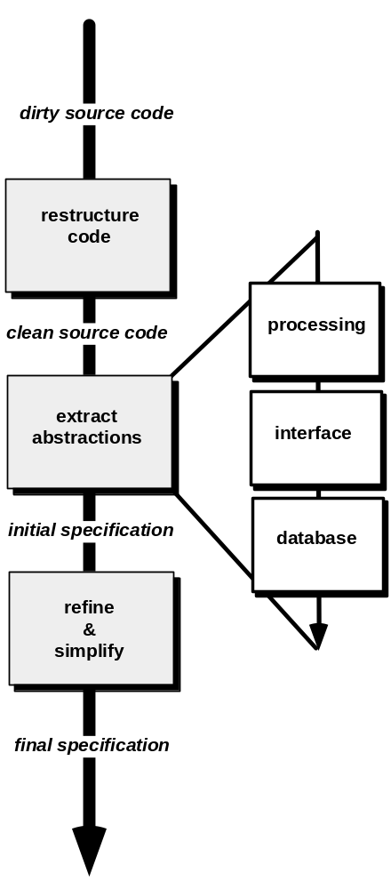
Reverse Engineering

Slide 126
Forward Engineering
1. The cost to maintain one line of source code may be 20 to 40 times the cost of initial development of that line.
2. Redesign of the software architecture (program and/or data structure), using modern design concepts, can greatly facilitate future maintenance.
3. Because a prototype of the software already exists, development productivity should be much higher than average.
4. The user now has experience with the software. Therefore, new requirements and the direction of change can be ascertained with greater ease.
5. CASE tools for reengineering will automate some parts of the job.
6. A complete software configuration (documents, programs and data) will exist upon completion of preventive maintenance.

Slide 127
Chapter 31
Computer-Aided Software Engineering

Slide 128
CASE
... in its idealized form, CASE combines a set of
software development tools that are
integrated
with a
data base to form an environment...
... the tools address each important step in the
software engineering process ...
... the tools increase insight thereby improving quality;
reduce drudgery thereby improving productivity; and
enhance control, thereby leading to on-time projects ...

Slide 129
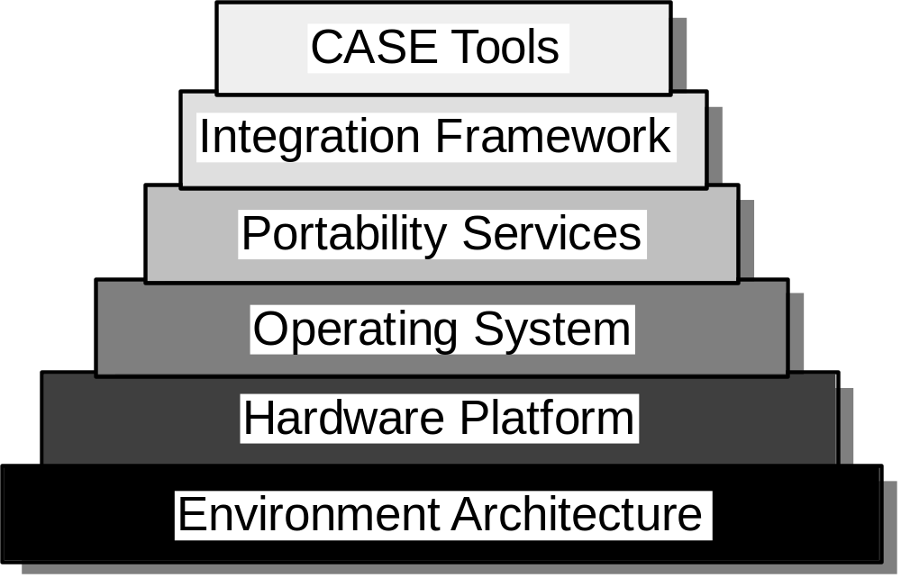
CASE Environment Model

Slide 130
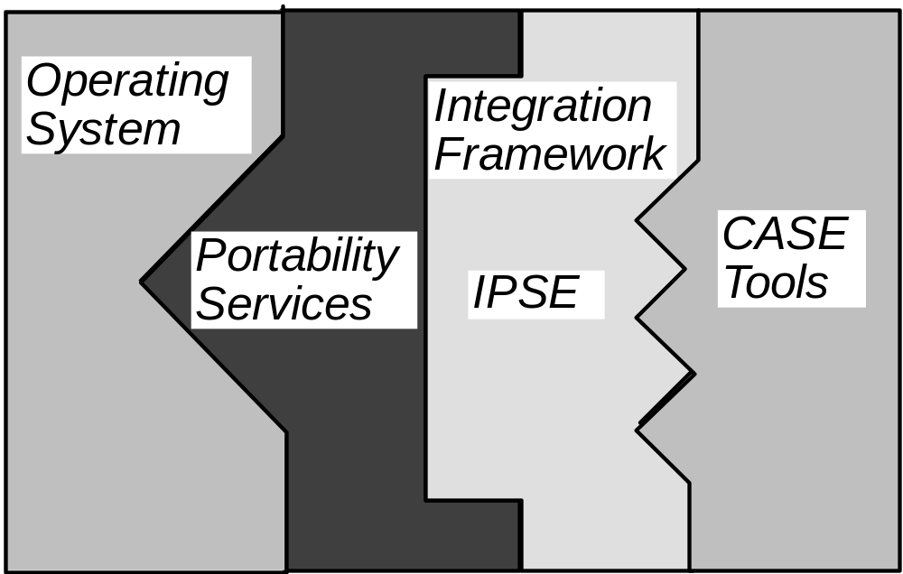
The Challenge: Putting it Together

Slide 131
An Integration Framework
user interface layer
interface tool kit
presentation protocol
tools management services
CASE
tools layer
tool
object management layer
integration services
configuration management services
shared repository layer
CASE database
access control functions

Slide 132
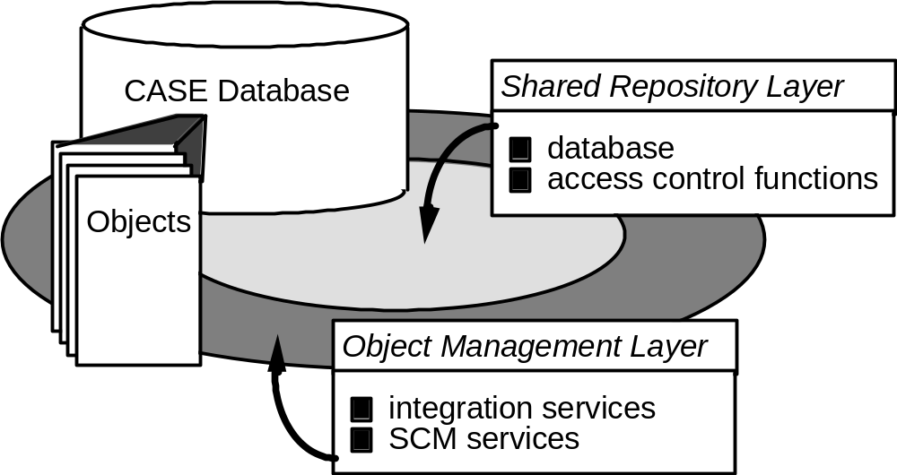
Data Integration:
The CASE Repository

Slide 133
A Taxonomy of CASE Tools
business systems planning
project management
support
CASE
analysis and design
Database
programming
integration &testing
prototyping/simulation tools
re–engineering
framework

Slide 134
Chapter 32
The Road Ahead

Slide 135
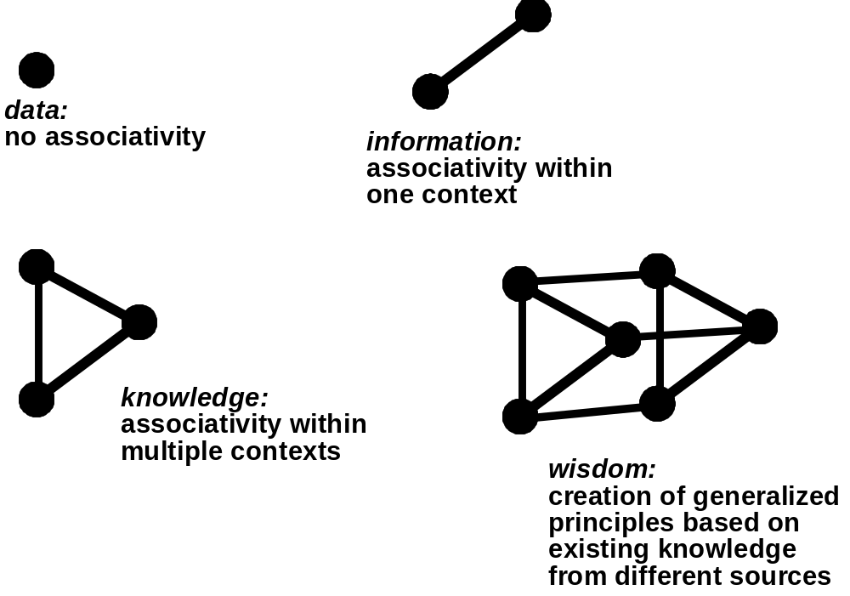
An Information Spectrum

Slide 136
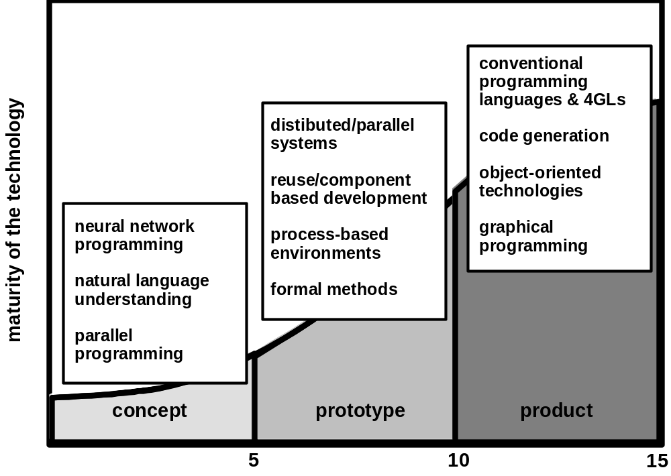
Software: The Road Ahead

